Slide 1
Introduce to Neural Network Training
報告人：蕭哲瑋
Notes:
1
1

Slide 2
OUTLINE
Introduction
Brief introduction of neural network
How to training a nueral network
Model bias vs. Optimization issue
Neural network training (Optimization methods)
Gradient descent
Momentum
Adagrad
Conclusion
Demo

Slide 3
Introduction
Notes:
3
3

Slide 4

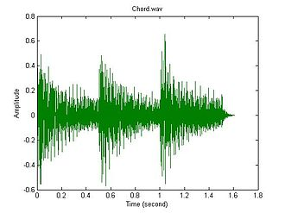
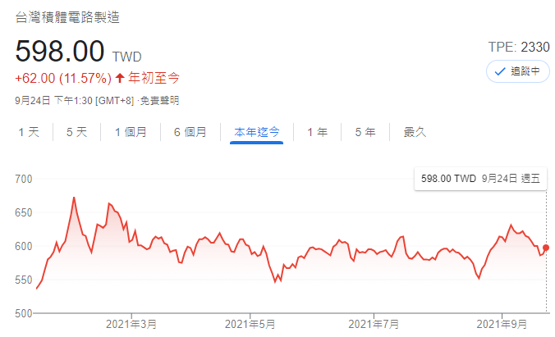
Introduction
Brief introduction of neural network
Neural Network
貓咪
Output
我愛台積電
Input data
Next day price

Slide 5
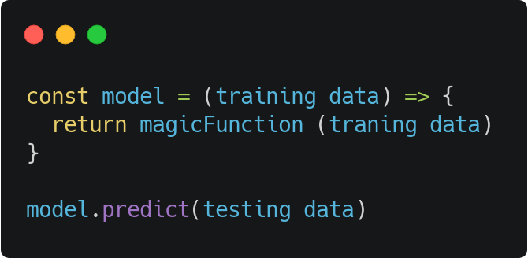
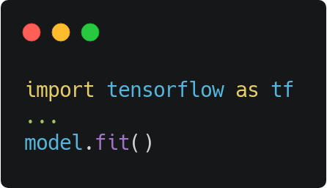
Introduction
Brief introduction of neural network
Neural Network
Input data
Output

Slide 6
Introduction
Brief introduction of neural network
y = sin(x)
y
y
y = 20 + 1.1 * x
x
x

Slide 7
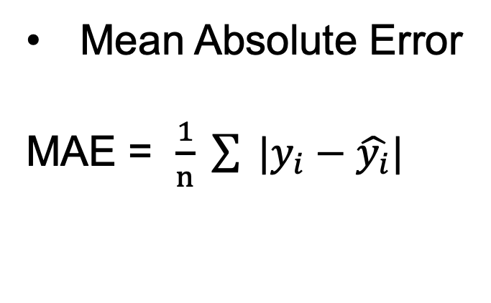
Introduction
Brief introduction of neural network
Loss function:
Mean Absolute Error
MAE = $\frac{1}{n} \sum{ |y_{i}−\hat{y_{i}}|}$
y
y = 20 + 1.1 * x
x
Regression : MAE, MSE, RMSE, MAPE
Classification : Cross-entropy

Slide 8

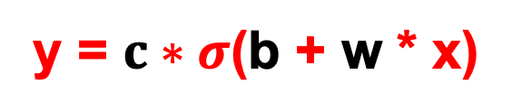
Introduction
Brief introduction of neural network
Linear regression
Activation function
Linear
y = b + w * x
x
w
+
y
y
b
non-linear
y = $c∗σ$(b + w * x)
x
w
+
y
x
Relu
sigmoid
b

Slide 9
Introduction
Brief introduction of neural network
Linear regression
Activation function
Linear
y = b + w * x
C
x
w
+
y
y
A
b
B
non-linear
y = $c∗σ$(b + w * x)
x
w
+
c
y
x
Relu
sigmoid
b

Slide 10
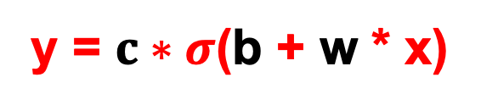
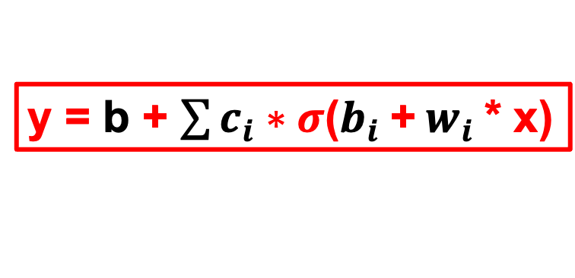
Introduction
y = b + $\sum{c_{i}∗σ\text{(}b_{i} \text{+} w_{i} \text{* }\text{x}\text{)}}$
Brief introduction of neural network
non-linear
y = $c∗σ$(b + w * x)
x
w
+
c
+
y
C
sigmoid
b
b
y
A
w
c
+
B
b
c
w
+
x
b

Slide 11
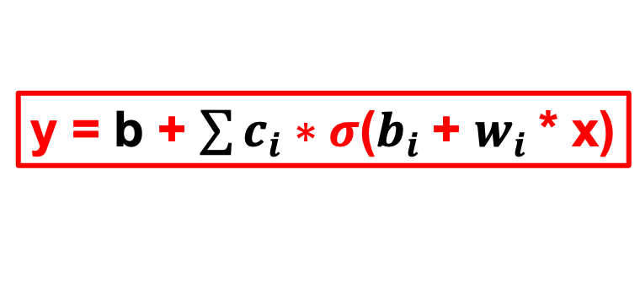
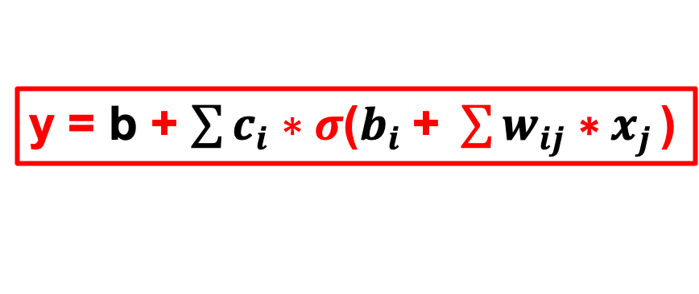
Introduction
y = b + $\sum{c_{i}∗σ\text{(}b_{i} \text{+} w_{i} \text{*} \text{x}\text{)}}$
Brief introduction of neural network
non-linear
y = $c∗σ$(b + w * x)
x
w
+
c
+
y
C
sigmoid
b
b
y
A
w
c
x
+
B
b
c
w
x
+
x
b
y = b + $\sum{c_{i}∗σ\text{(}b_{i} \text{+ }\sum{w_{ij} \text{∗} x_{j}}\text{)}}$

Slide 12
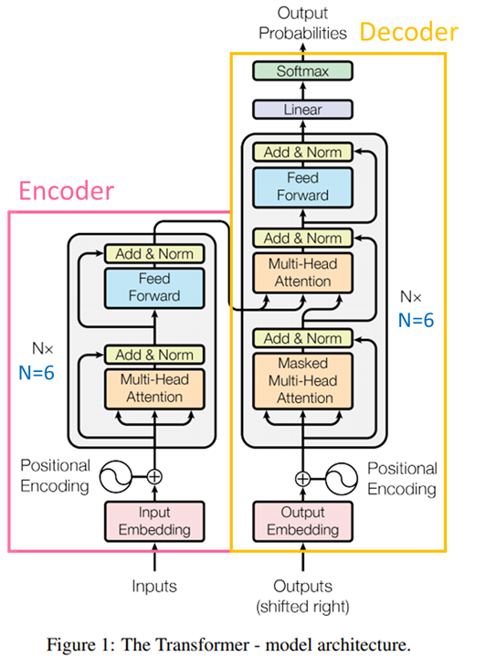
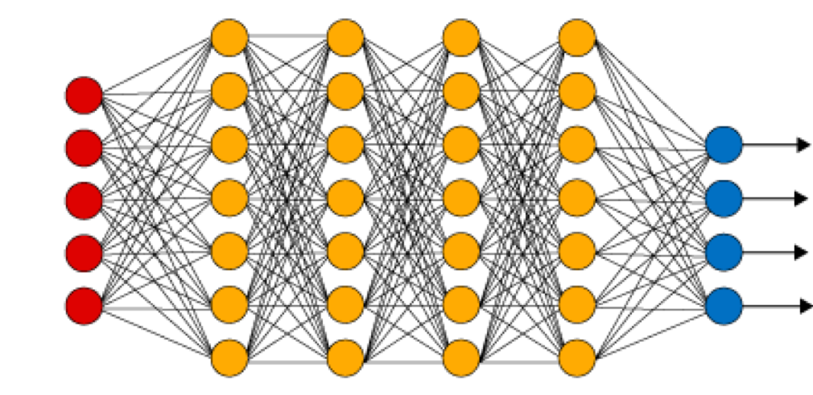
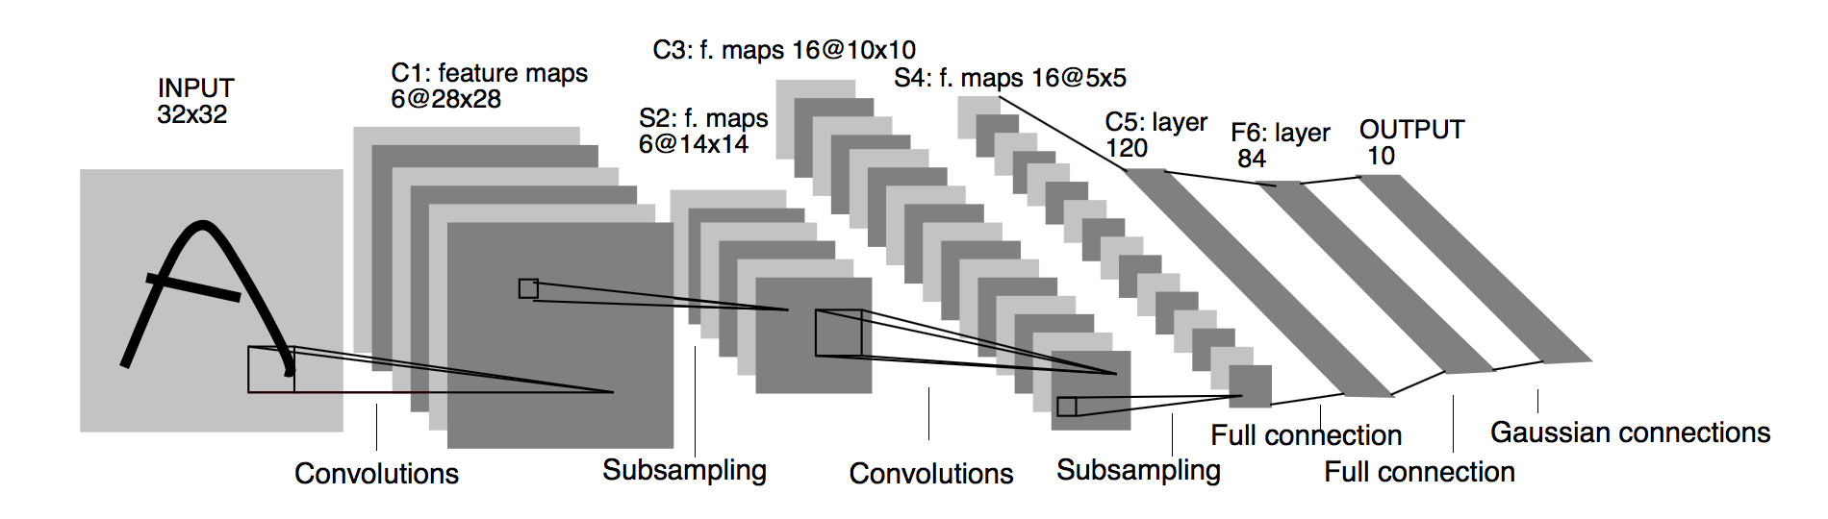
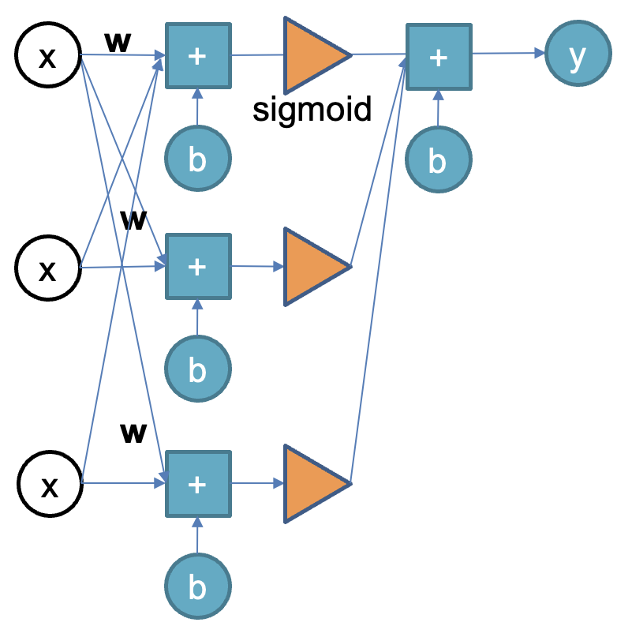
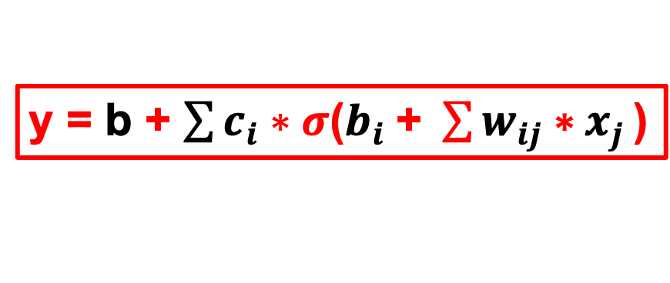
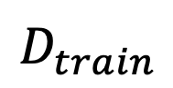

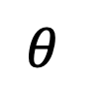
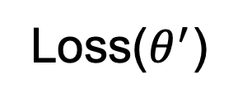
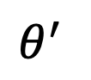
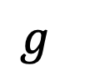
Introduction
y = 20 + 1.1 * x
How to training a nueral network
$$θ^{∗}$$
Architecture
Hyper
Optimizer
model
Network
Network
Init weight
$$θ$$
Parameter update
$$θ^{′}$$
Loss($θ^{′}$)
y = b + $\sum{c_{i}∗σ\text{(}b_{i} \text{+ }\sum{w_{ij} \text{∗} x_{j}}\text{)}}$
$$g$$
Loss function
# of layers
# of nuerons
Batch size
Validation size
Dropout rate
…
Compute gradient
$$D_{train}$$
Backward propagation

Slide 13
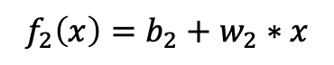
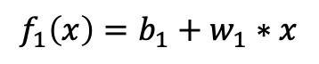
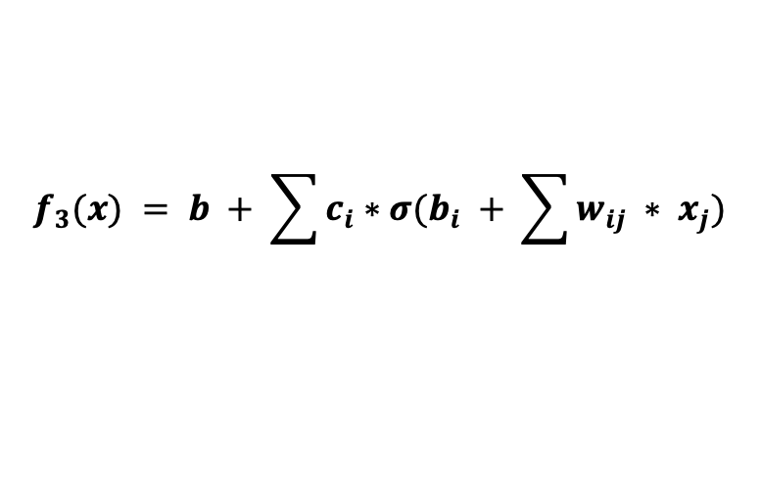
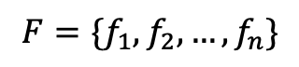
Introduction
`
Model bias vs. Optimization issue
w
x
w
+
c
+
y
x
+
y
sigmoid
b
b
b
$$f_{1}\left(x\right)=b_{1}+w_{1}∗x$$
w
c
+
$$f_{2}\left(x\right)=b_{2}+w_{2}∗x$$
y
$$F=\{f_{1}, f_{2}, …, f_{n}\}$$
b
c
w
Parameters
+
$$f_{3}(x) = b + \sum{c_{i}∗σ(b_{i} + \sum{w_{ij} ∗ x_{j}})}$$
b
x
Model’s flexibility

Slide 14

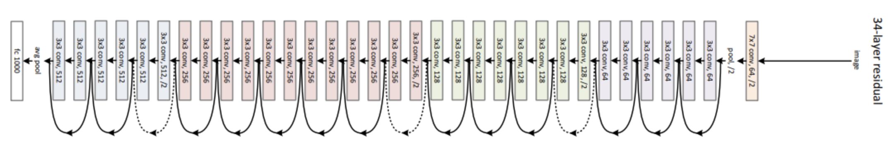
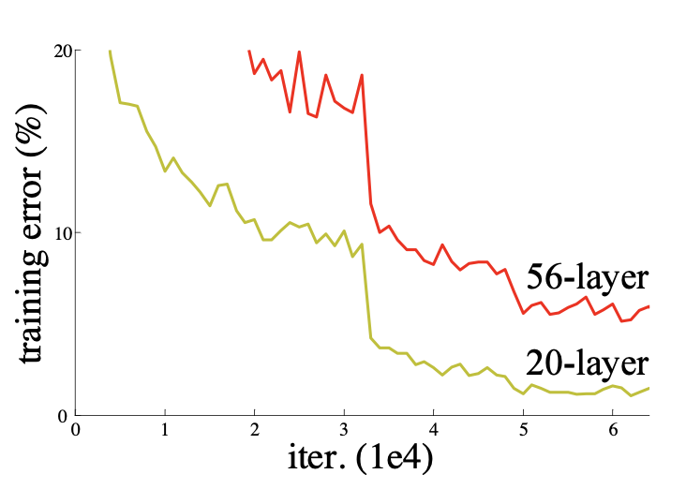
Introduction
`
Model bias vs. Optimization issue
20-layer
56-layer
Parameters
Model’s flexibility

Slide 15
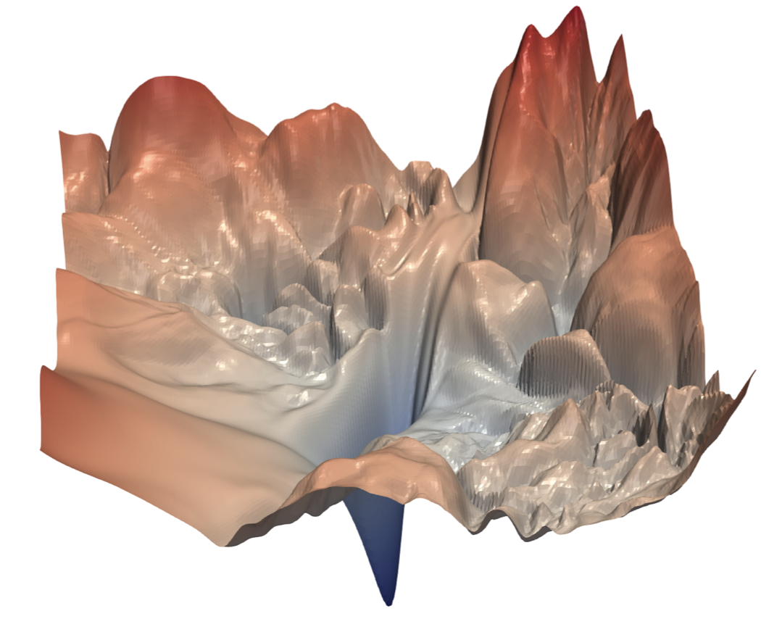
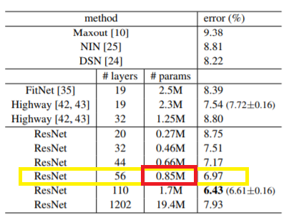
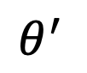
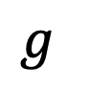
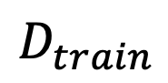
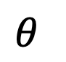
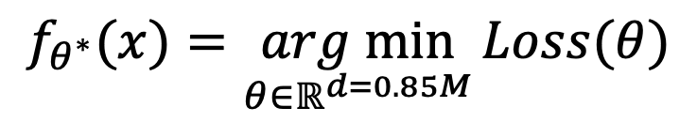
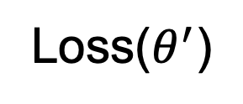
Introduction
`
Model bias vs. Optimization issue
Optimizer
model
Initial point
Init weight
Parameter update
$$θ$$
$$θ^{′}$$
56-layer
Loss($θ^{′}$)
$$g$$
Compute gradient
$$D_{train}$$
$$f_{θ^{∗}}(x)=\underset{θ∈ℝ^{d=0.85M}}{arg min}{Loss(θ)}$$
Backward propagation

Slide 16
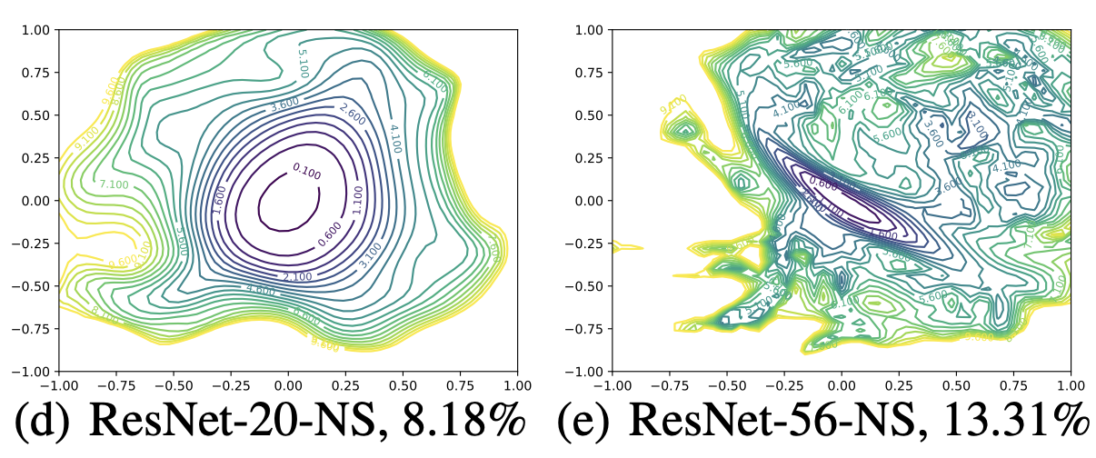
Introduction
`
Model bias vs. Optimization issue
20-layer
20-layer
56-layer
Feature Normalization
Re-design Architecture
Powerful
Optimizer
56-layer

Slide 17

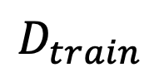
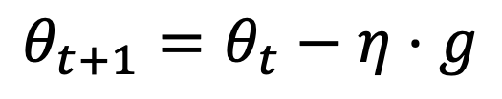
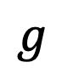
Introduction
Model bias vs. Optimization issue
Gradient Descent
Optimizer
$$θ_{t+1}=θ_{t}−η⋅g$$
Parameter update
x2
y
$$g$$
Local minima
Compute gradient
$$D_{train}$$
Global minima
x1
x2
gradient

Slide 18
Optimization methods
Notes:
18
18

Slide 19
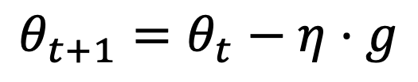
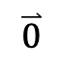
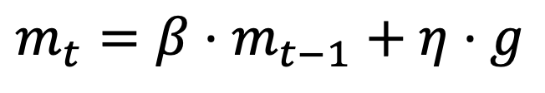
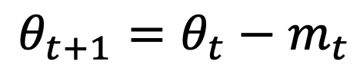
Optimization methods
Momentum
Gradient Descent
$$θ_{t+1}=θ_{t}−η⋅g$$
Momentum
y
$$θ_{t+1}=θ_{t}−m_{t}$$
Local minima
$$m_{t}=β⋅m_{t−1}+η⋅g$$
Global minima
$$\overset{⃑}{0}$$
update 1
update 1
x2
update 2
update 2
gradient
inertia

Slide 20
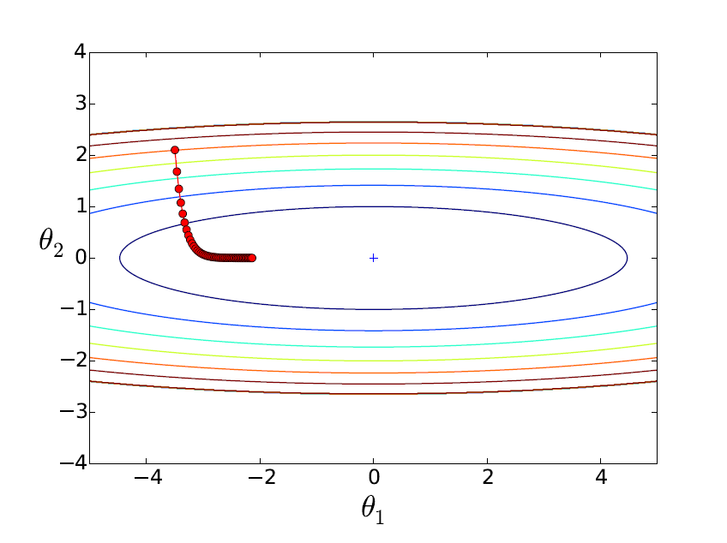
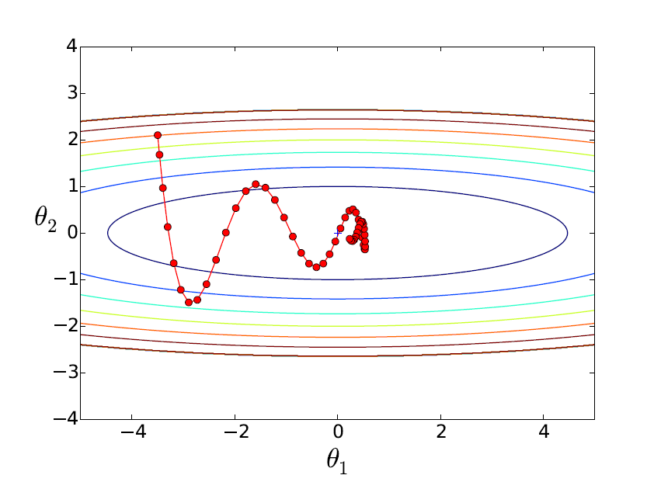
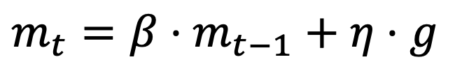
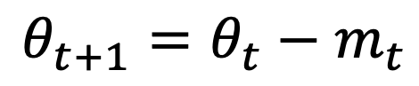
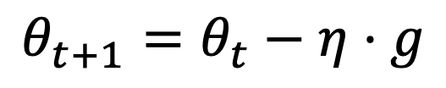
Optimization methods
Gradient Descent
Momentum
$$θ_{t+1}=θ_{t}−η⋅g$$
$$θ_{t+1}=θ_{t}−m_{t}$$
$$m_{t}=β⋅m_{t−1}+η⋅g$$

Slide 21
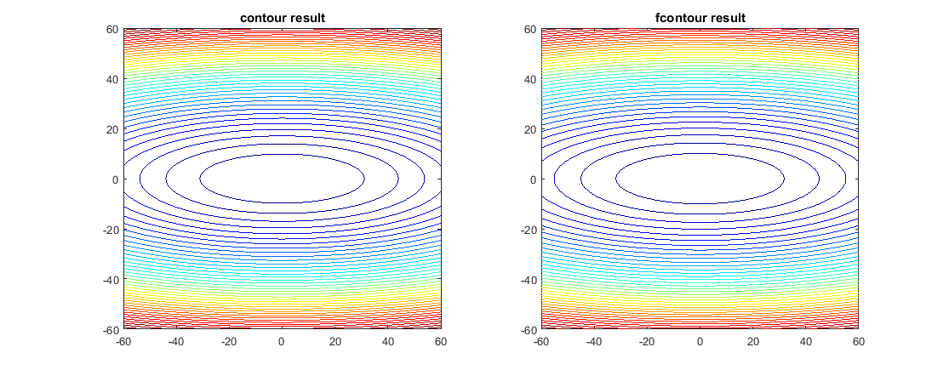
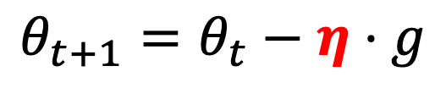
Optimization methods
Adagrad
Gradient Descent
Due to same learning rate
$$θ_{t+1}=θ_{t}−η⋅g$$

Slide 22
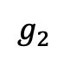




Optimization methods
Adagrad
Adagrad
$$θ_{t+1}=θ_{t}−\frac{η}{\sqrt{G_{t}}}⋅g$$
$$G_{t}=G_{t−1}+g^{2}$$
Statistical Analysis
$$g_{0}$$
$$g_{1}$$
$$g_{2}$$

Slide 23
Optimization methods
Adagrad
Adagrad
$$θ_{t+1}=θ_{t}−\frac{η}{\sqrt{G_{t}}}⋅g$$
$$G_{t}=G_{t−1}+g^{2}$$
Statistical Analysis
$$g_{0}$$
$$g_{1}$$
$$g_{2}$$

Slide 24


Optimization methods

Slide 25
Conclusion
Notes:
25
25

Slide 26

Conclusion
Neural Network
x
w
+
c
+
y
sigmoid
b
b
w
c
x
+
b
20-layer
c
w
56-layer
x
+
y
C
b
A
B
y = b + $\sum{c_{i}∗σ\text{(}b_{i} \text{+ }\sum{w_{ij} \text{∗} x_{j}}\text{)}}$
x

Slide 27
Demo
Notes:
27
27

Slide 28

Thank You ;-)
https://www.youtube.com/playlist?list=PLJV_el3uVTsMhtt7_Y6sgTHGHp1Vb2P2J
Machine Learning (2021) Mandarin Version - 40
Hung-yi Lee
Notes:
28
28

